Slide 1
Global Female literacy rate and developmental outcomes
Patricia escalante, David levy, Andrew park, eyob Gebrerufael

Slide 2
Research Question
Studies indicate that increases in female literacy rate strongly correlate with numerous positive social and developmental outcomes. We wanted to test and visualize this claim across both countries/regions and years.
Does the female literacy rate correlate with other developmental indicators?
Mortality rate
Female participation in the labor market
We chose to answer these questions using data from the World Bank from the period of 1990 to the present.

Slide 3
Data Collection and Cleaning: Challenges
Though we anticipated a strong correlation between our variables, visualizing that relationship presented numerous challenges.
Large gaps in the data on literacy
Large amounts of country-level data across many years
Literacy rate or labor participation rate among women is not especially revealing unless you know how that compares to the overall literacy and labor participation rate.

Slide 4
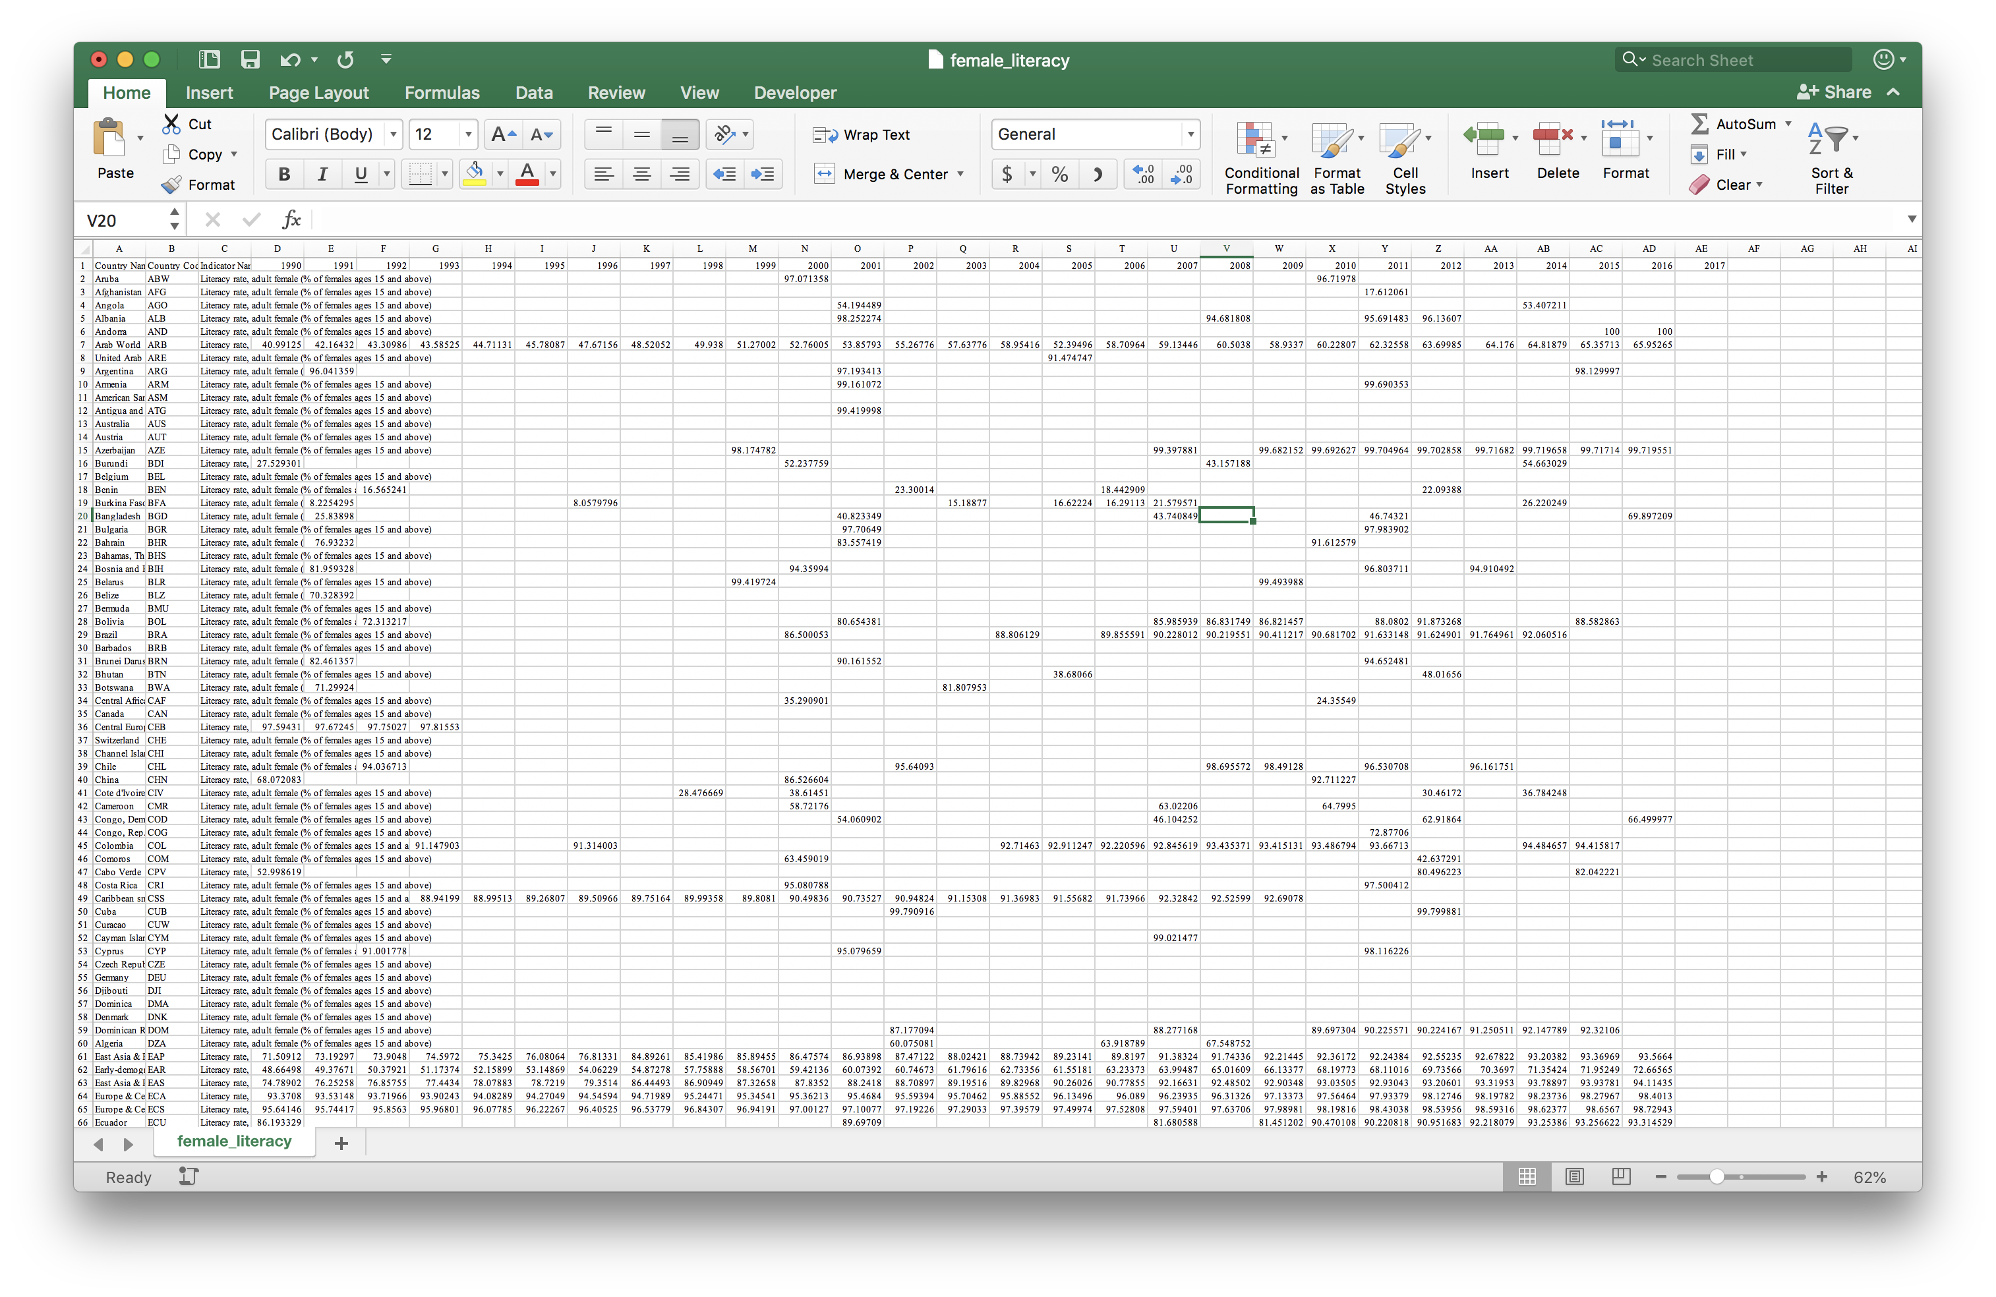
Example: Sparse Data on literacy

Slide 5
Data Collection and Cleaning: Solutions
Rather than plotting both female and male literacy and employment rates, decided to create ratios that showed how likely women are to be literate and employed relative to men.
To deal with spotty data, especially in literacy rate, took the mean across all years in the period considered (UNESCO overcomes this same problem by reporting only the most recent year available)
To handle the great number of country data and years, we employed two strategies:
Generated maps to show country-level data for individual years
Work with regional-level data for to create line charts that plot change over time

Slide 6
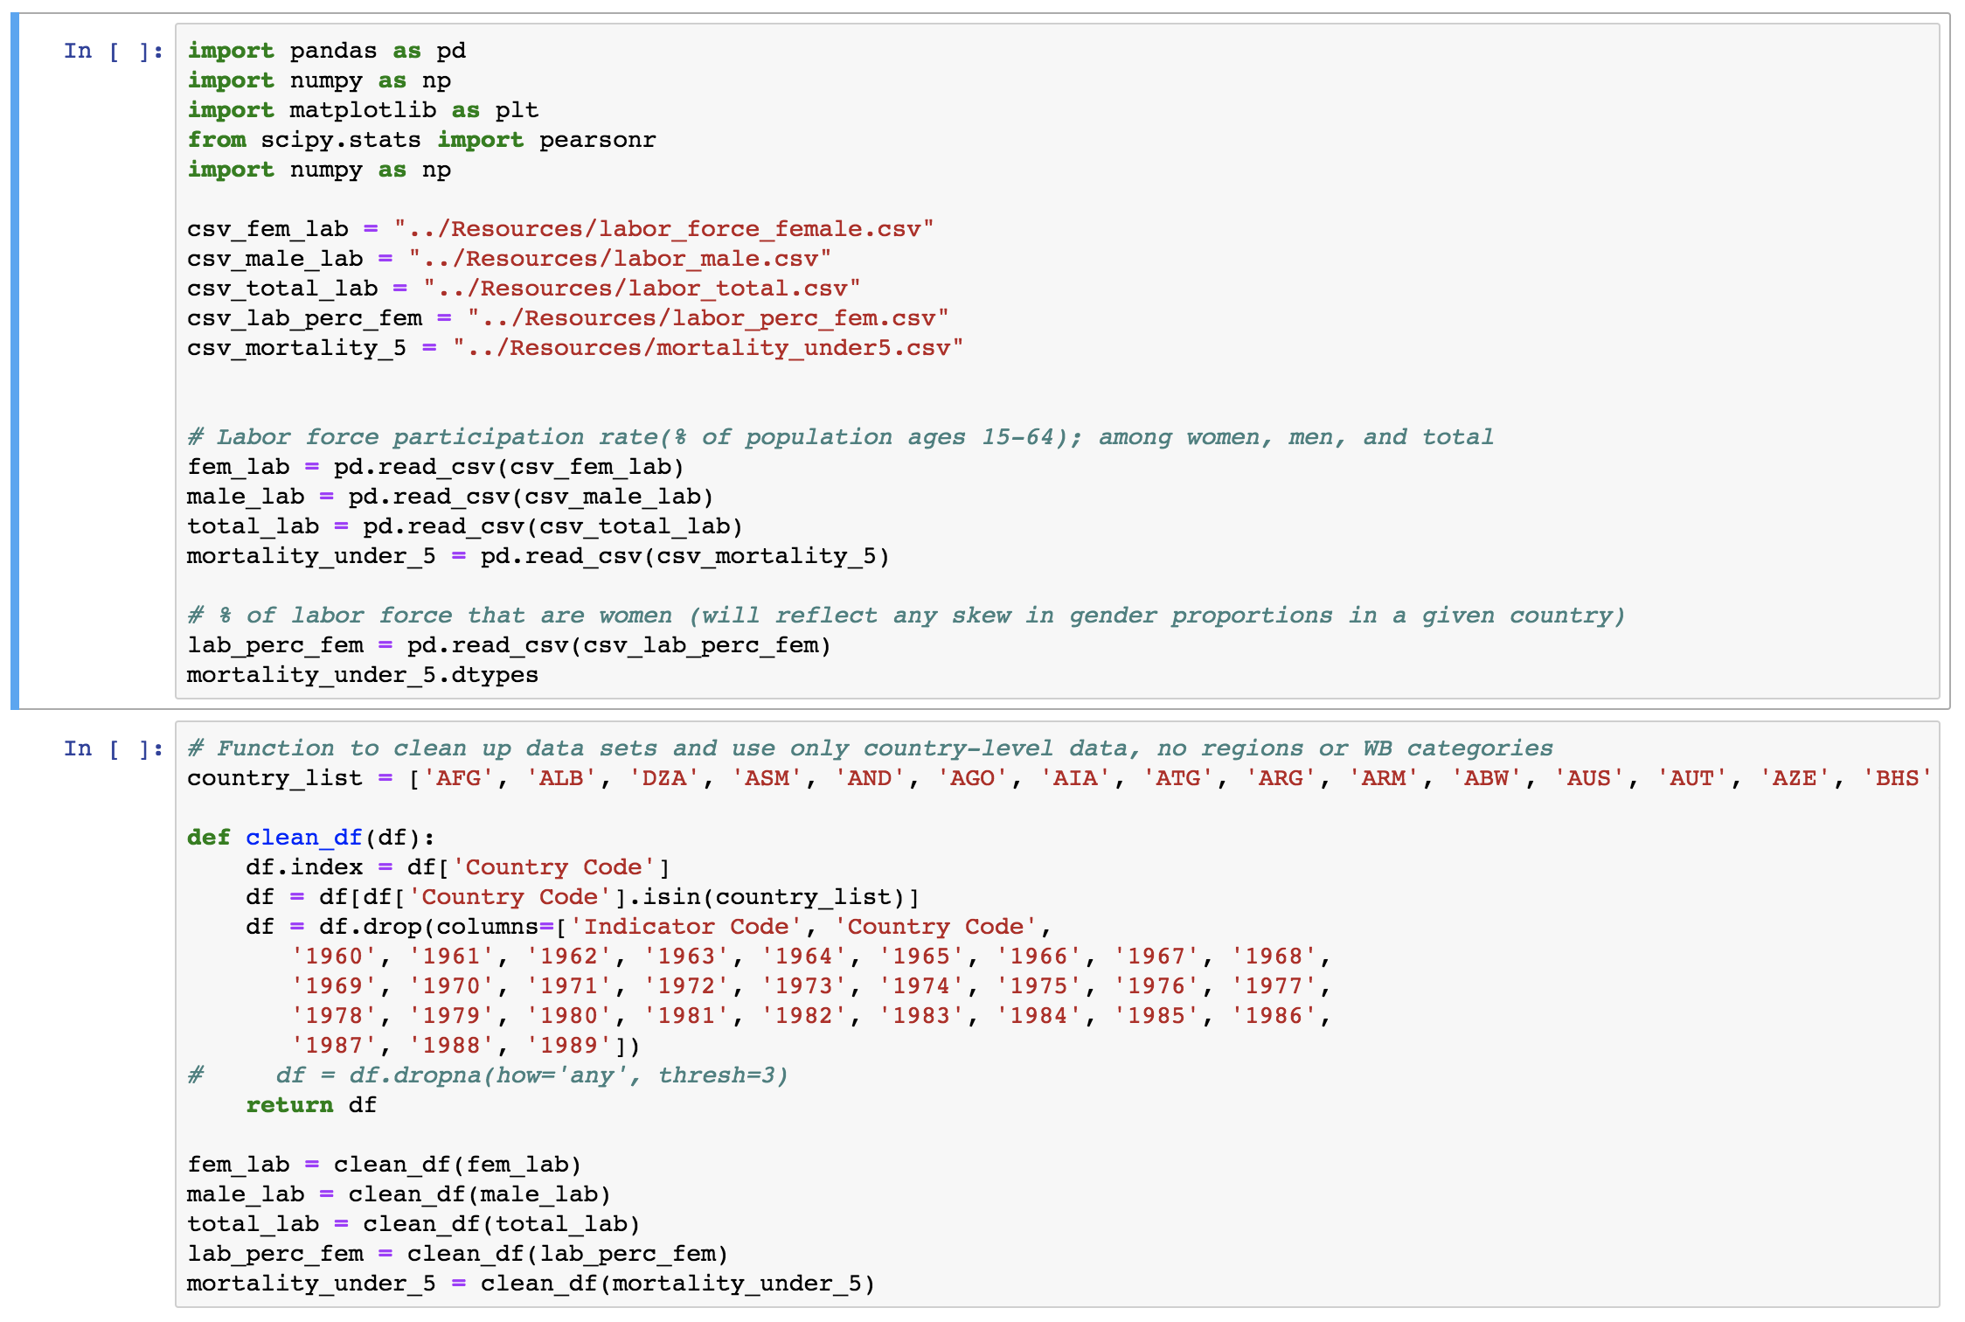
Code Example: Cleaning the Data

Slide 7
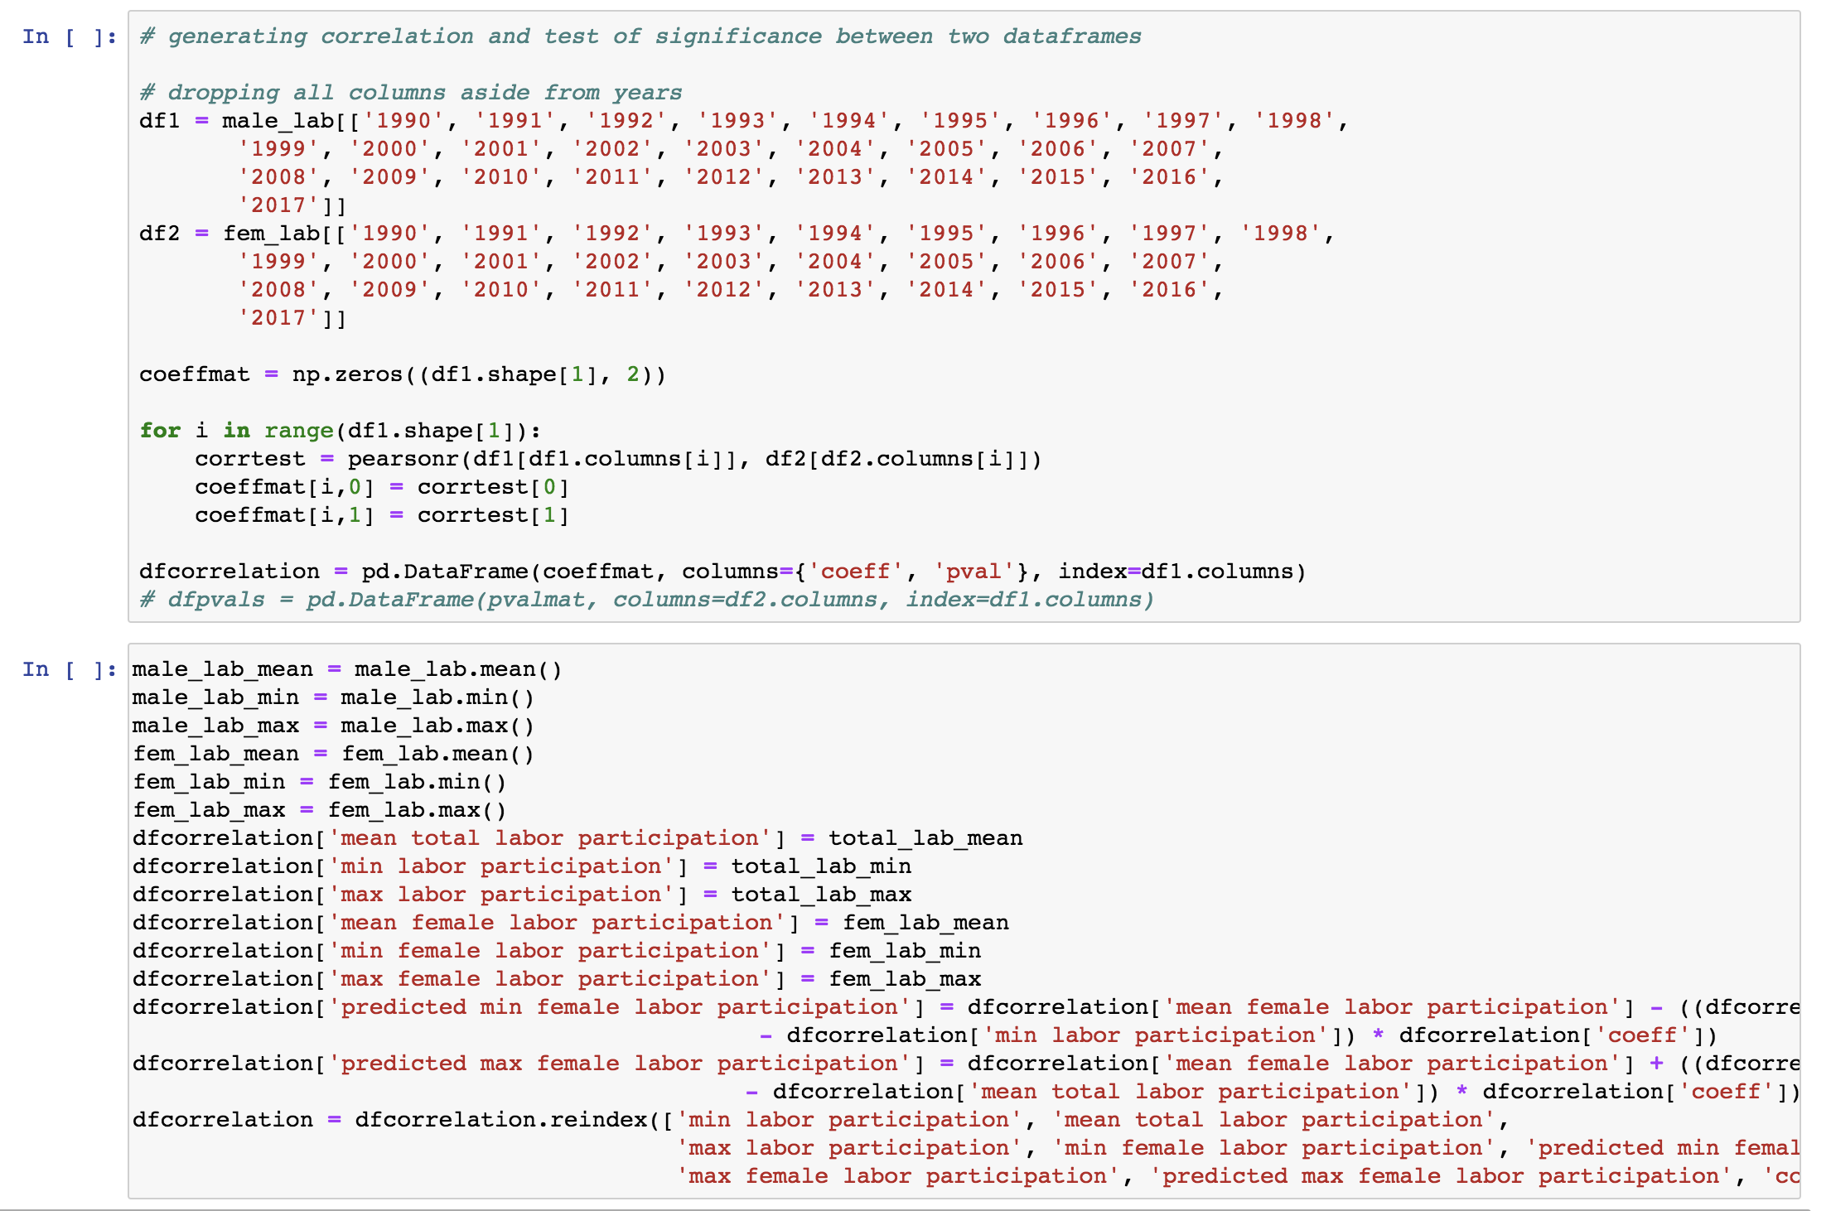
Code example: Running Correlations

Slide 8
labor participation across years
 | mean total labor participation | mean female labor participation | coeff | pval
2000 | 66.81300192 | 49.76036518 | 0.295389916 | 5.68E-05
2001 | 66.90564475 | 49.99031241 | 0.312971032 | 1.89E-05
2002 | 66.94039352 | 50.16149972 | 0.32073807 | 1.14E-05
2003 | 67.01873272 | 50.33043857 | 0.326716894 | 7.60E-06
2004 | 67.10832025 | 50.49004541 | 0.332429629 | 5.13E-06
2005 | 67.31056539 | 50.79213491 | 0.332301829 | 5.18E-06
2006 | 67.50939761 | 51.08724106 | 0.345199661 | 2.08E-06
2007 | 67.65249302 | 51.29095653 | 0.350308898 | 1.43E-06
2008 | 67.76138063 | 51.45018199 | 0.352980854 | 1.17E-06
2009 | 67.77912682 | 51.53553047 | 0.347671908 | 1.74E-06
2010 | 67.76462411 | 51.54366217 | 0.346986031 | 1.82E-06
2011 | 67.85800162 | 51.65261986 | 0.346170341 | 1.94E-06
2012 | 68.00781012 | 51.86392037 | 0.34508543 | 2.09E-06
2013 | 68.13586115 | 51.94382553 | 0.346590039 | 1.88E-06
2014 | 68.26518424 | 52.03084685 | 0.348599484 | 1.62E-06
2015 | 68.43588175 | 52.16126173 | 0.338510245 | 3.35E-06
2016 | 68.53389165 | 52.20755124 | 0.339023488 | 3.23E-06
2017 | 68.62426607 | 52.20812356 | 0.340970262 | 2.82E-06

Slide 9
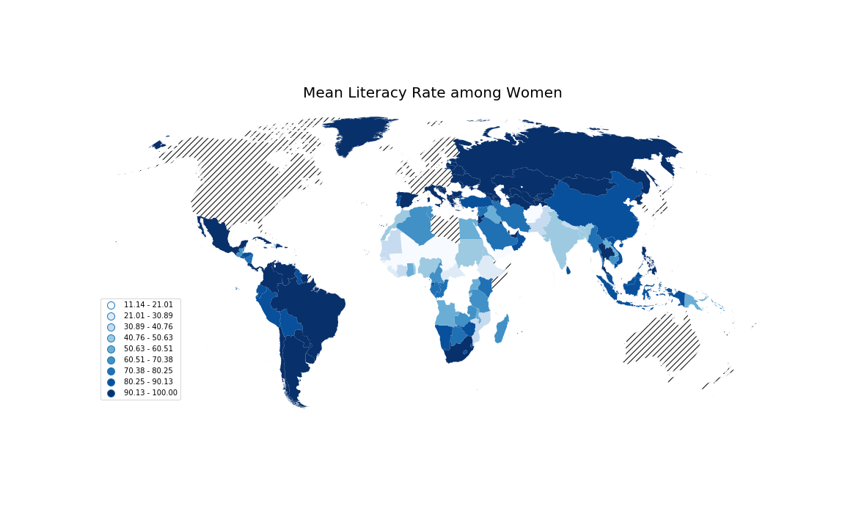
Literacy data: Global Literacy Rate for Women over 15 years of age from 1990-2017

Slide 10
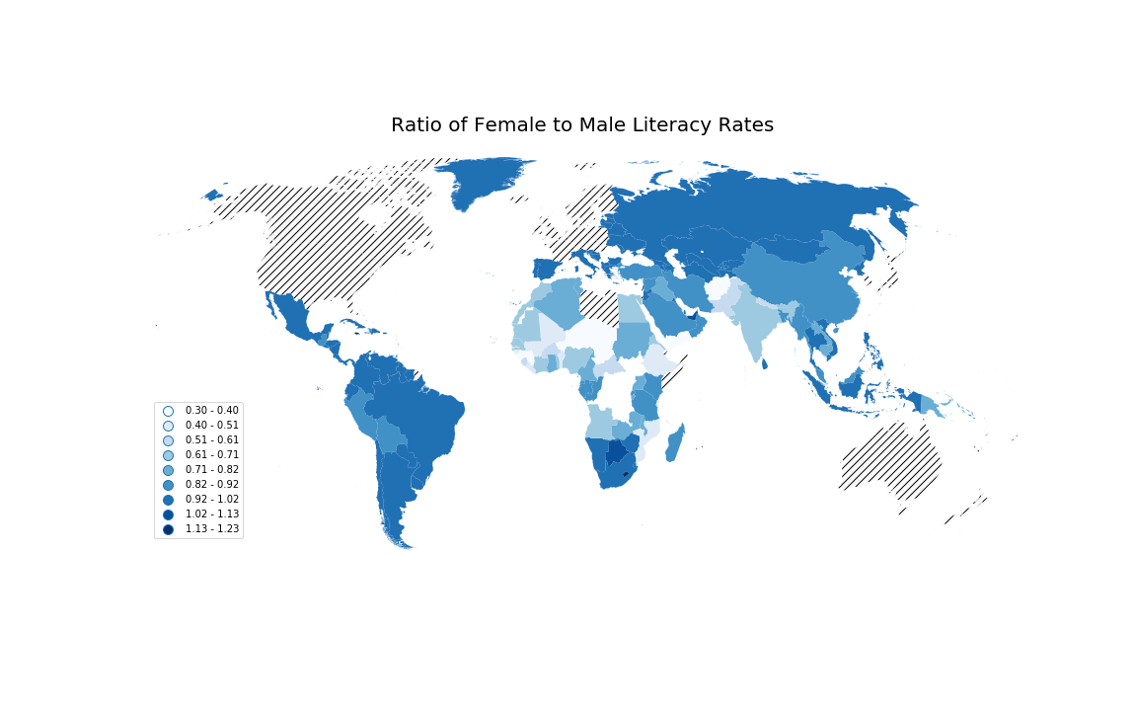
Literacy data: Ratio of Female to Male Literacy from 1990 to 2017

Slide 11
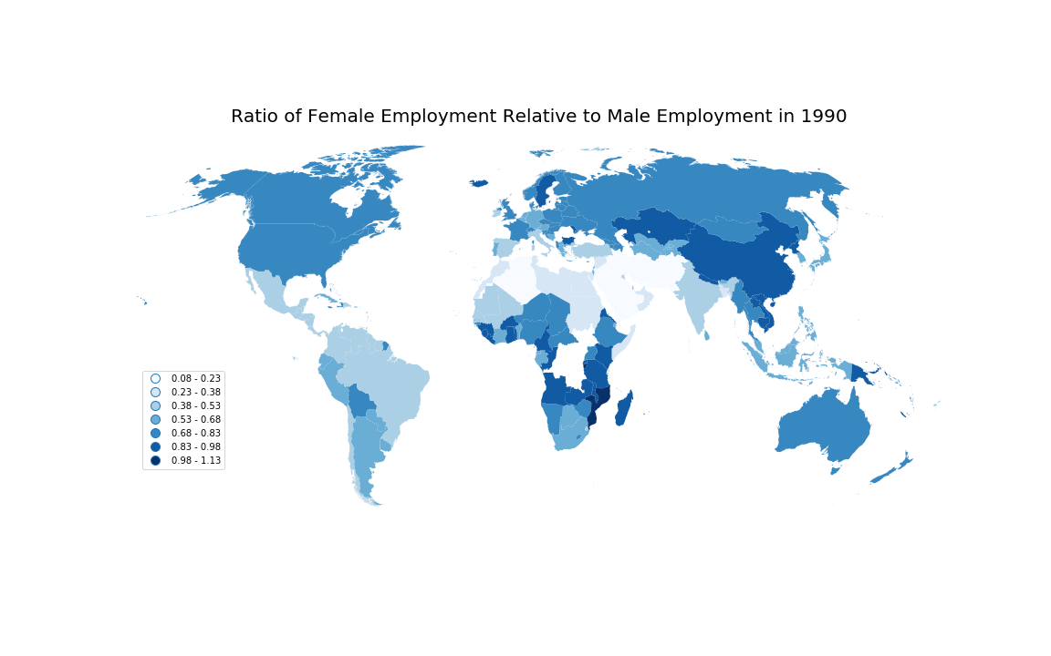
Labor: Ratio of female to male participation in the labor market in 5-year increments

Slide 12
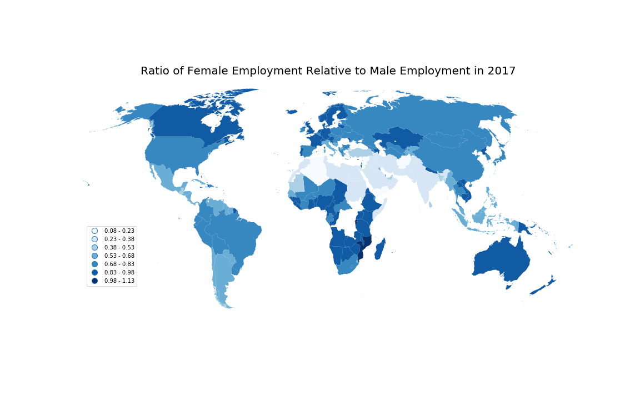
Labor: Ratio of female to male participation in the labor market in 2017

Slide 13
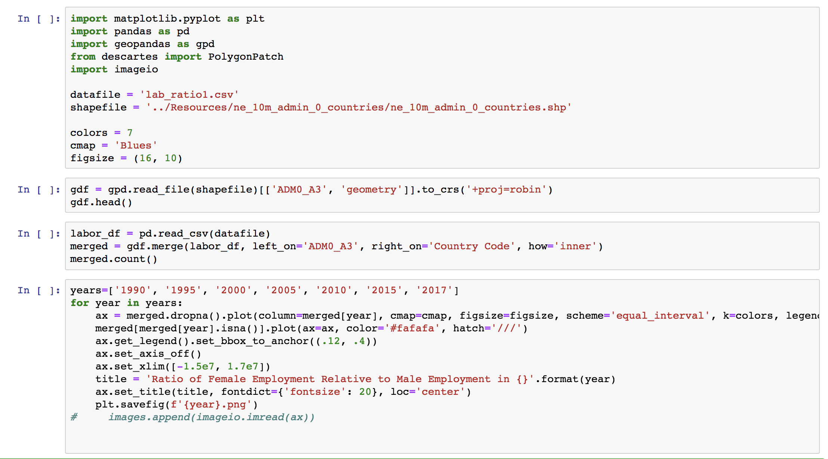
Mapping data

Slide 14
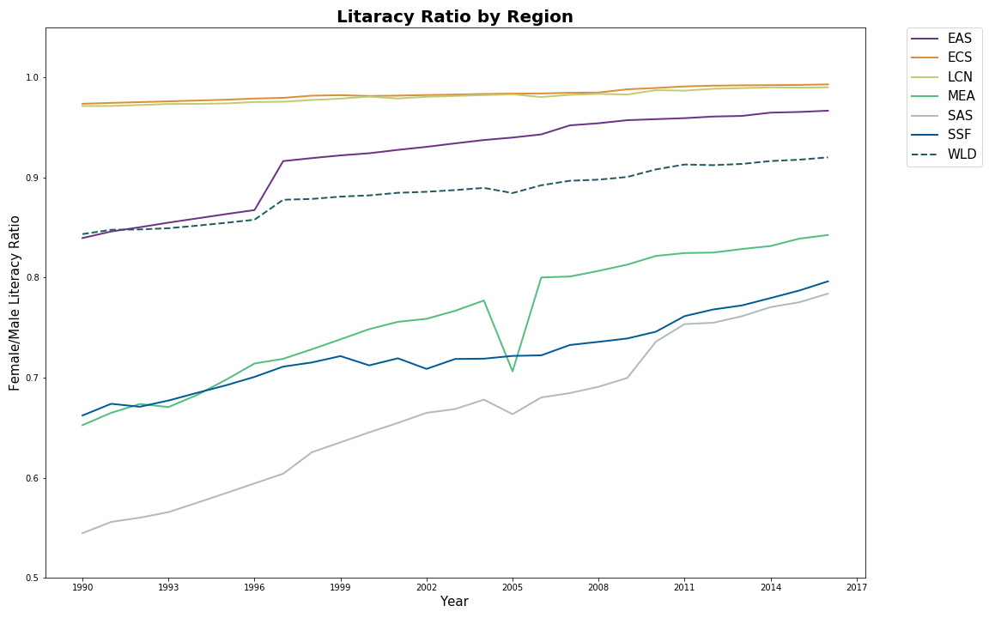
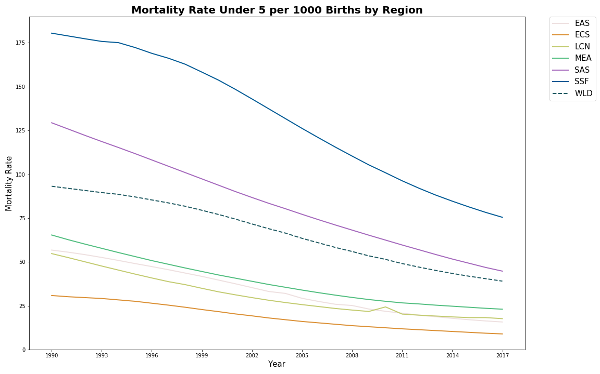
Literacy Ratio and mortality rate By region
Literacy Ratio
Mortality Rate

Slide 15
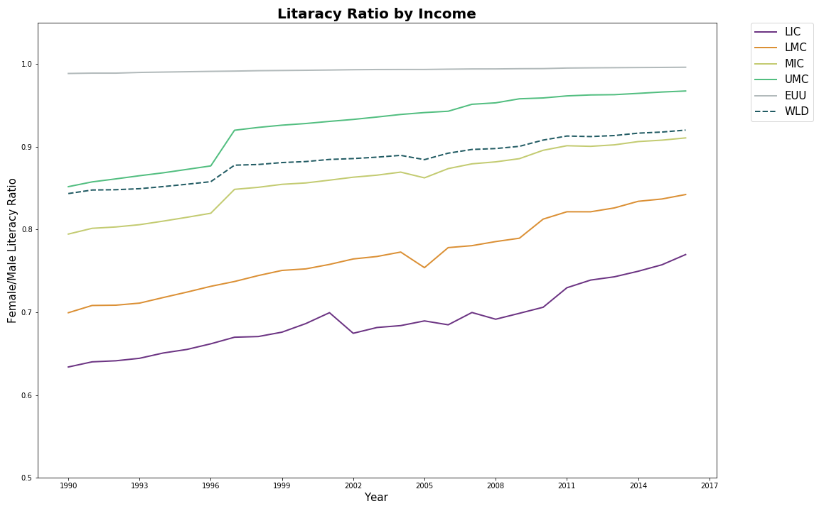
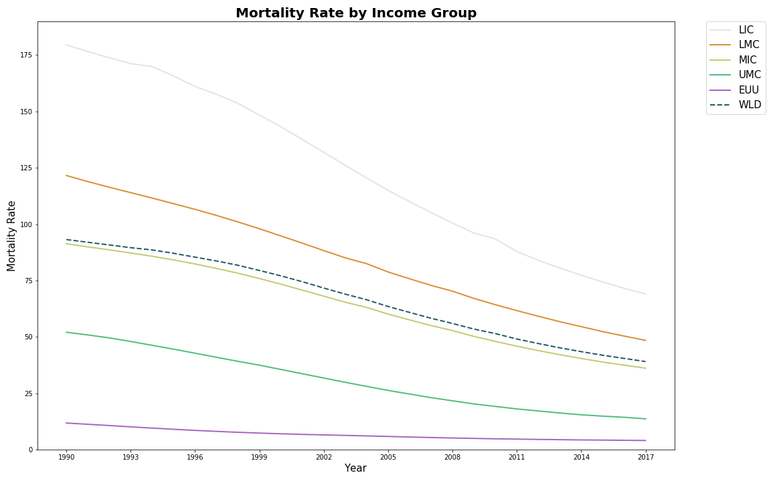
Literacy Ratio and mortality rate by Country Income Group
Literacy Ratio
Mortality Rate

Slide 16
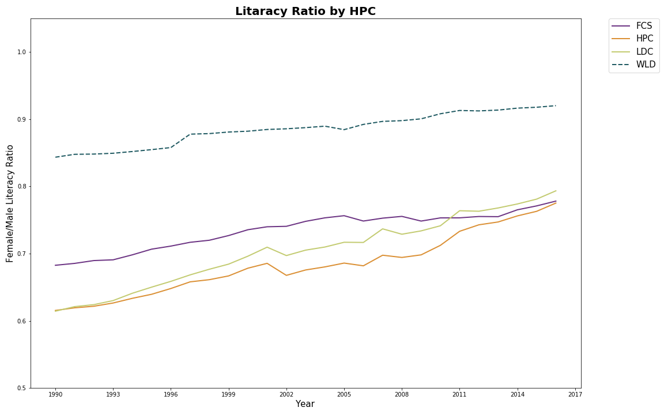
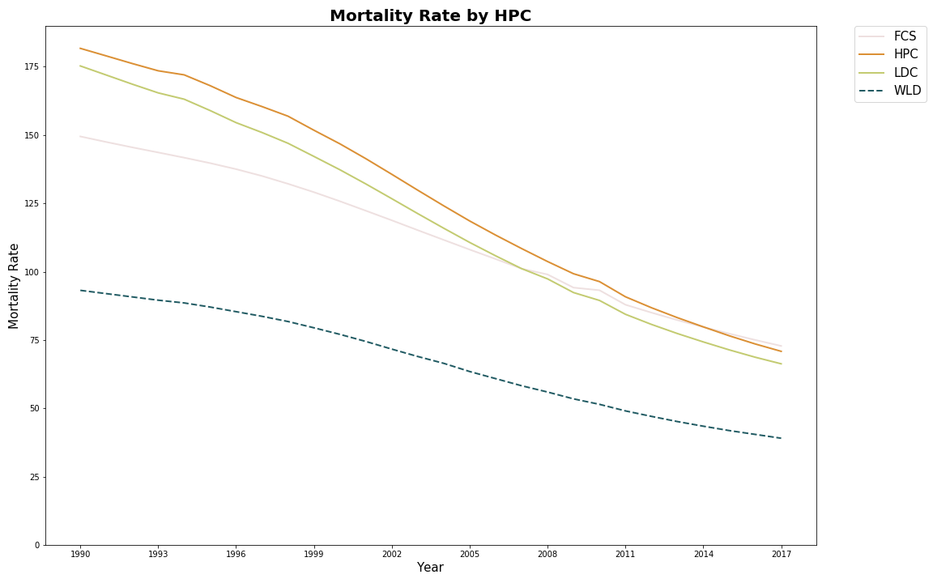
Literacy Ratio and mortality rate for Heavily Indebted Poor Countries (HIPC)
Literacy Ratio
Mortality Rate

Slide 17
Line plots

Slide 18
Line plots

Slide 19
Correlations: Female literacy
 | Correlation Coefficient | P-Value
Mortality Rate | -0.73134 | 2.3082513e-24
Female Participation in labor force | -0.03122 | 0.7161995

